Slide 1
Project Report of Data Analytics
BY
SAMYUKTHA S R

Slide 2
Heart Disease Diagnostic Analysis

Slide 3
Problem Statement
Health is real wealth in the pandemic time we all realized the brute effects of covid-19 on all irrespective of any status. You are required to analyze this health and medical data for better future preparation. Do ETL: Extract- Transform and Load data from the heart disease diagnostic database You can perform EDA through python. The database extracts various information such as Heart disease rates, Heart disease by gender, by age. You can even compare attributes of the data set to extract necessary information. Make the necessary dashboard with the best you can extract from the data. Use various visualization and features and make the best dashboard .Find key metrics and factors and show the meaningful relationships between attributes. Do your own research and come up with your findings.

Slide 4
Data Attributes
age and sex
cp-chest pain type (4 values)
trestbps-resting blood pressure
chol-serum cholesterol in mg/dl
fbs-fasting blood sugar > 120 mg/dl
restecg-resting electrocardiographic results (values 0,1,2)
thalach-maximum heart rate achieved
exang-exercise induced angina
oldpeak -ST depression induced by exercise relative to rest
slope-the slope of the peak exercise ST segment
ca-number of major vessels (0-3) colored by flourosopy
thal- 0 = normal; 1 = fixed defect; 2 = reversable defect
target-1:Yes ,0:No

Slide 5
Main KPI’s
Age
Sex
Chest Pain Types
Coronary Arteries
Thalach
Thalassemia
Exang

Slide 6
Tools and Techniques Used
Power Query
Data Cleaning
Excel
Data Aggregation using Pivot Tables
SQL
Exploratory Data Analysis(EDA)
Data Transformation
Power BI
Data Visualization
Dynamic Interactive Dashboard

Slide 7




Results
The result achieved shows the meaningful insights that above 60 years old people have 91% of getting heart disease.
And the 66% of males have heart disease diagnosed analyzed over the factors such as Coronary Arteries (Vessels of heart been affected), Types of Chest Pain, Thalassemia (Blood Disorder), Thalach (Maximum heart rate achieved ), Exang (Chest pain during physical activities).

Slide 8
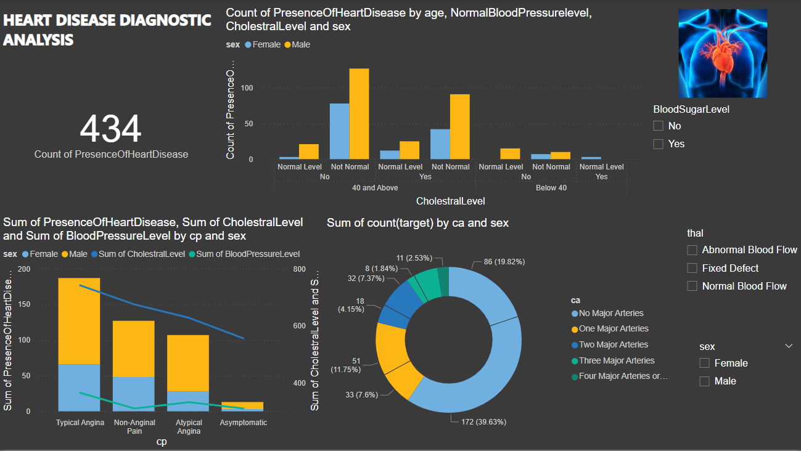
Dashboard of my Analysis (contd…)

Slide 9
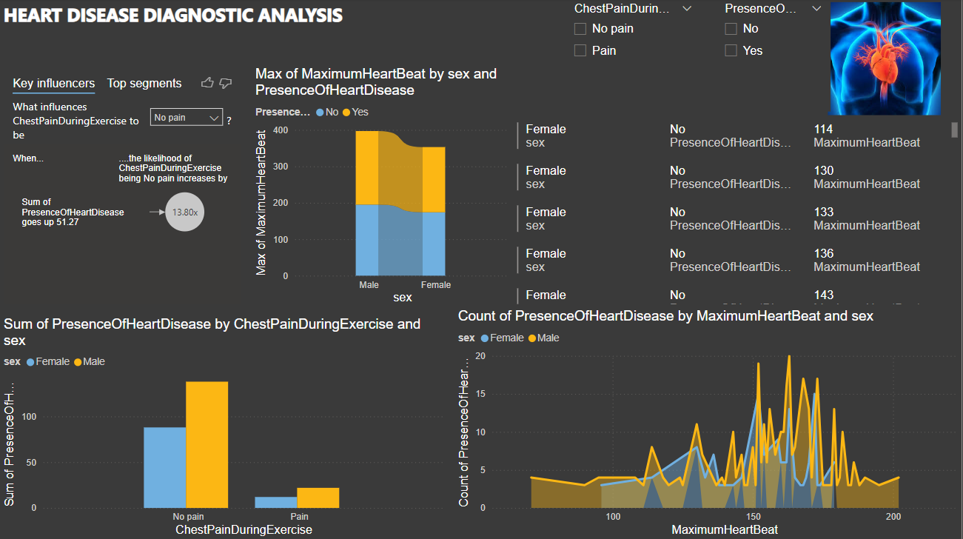
Dashboard of my Analysis

Slide 10
Thank You

